Slide 1



Slide 2
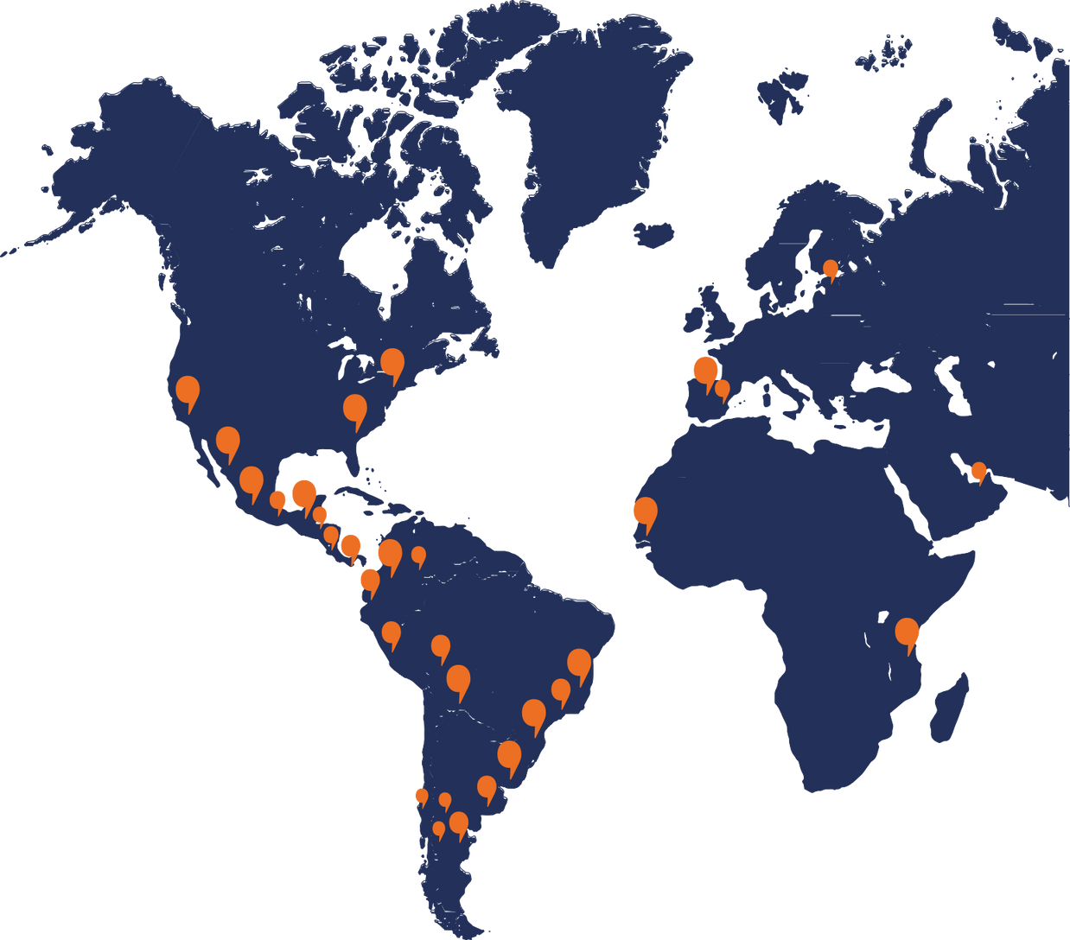


We are a think-do-tank that designs and implements political innovations
to develop equal, inclusive and participatory democracies in the Global South.

Slide 3





How we work
Generating open knowledge, tools and methodologies
Collaborating with institutions and communities in transformation processes
Developing innovative leadership
Promoting collaborative networks for debate and advocacy

Slide 4



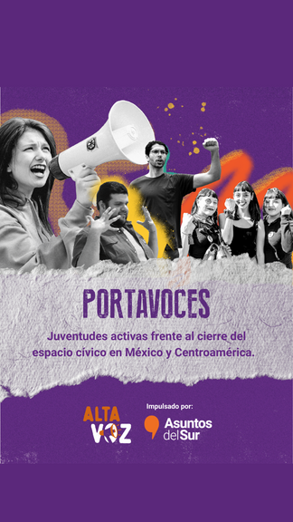
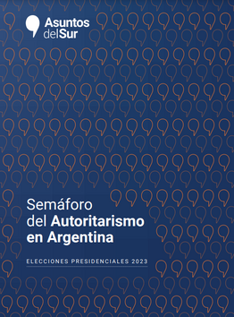
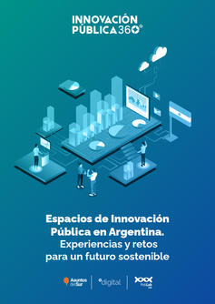
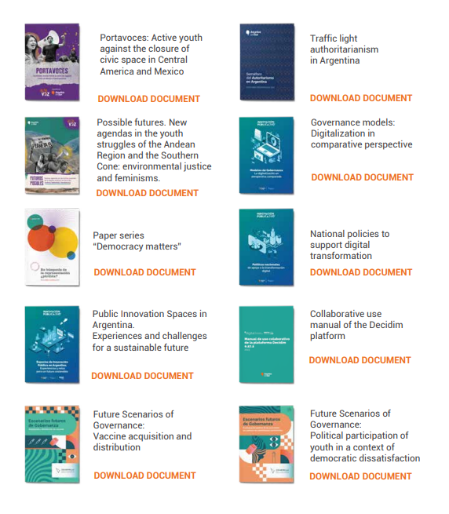
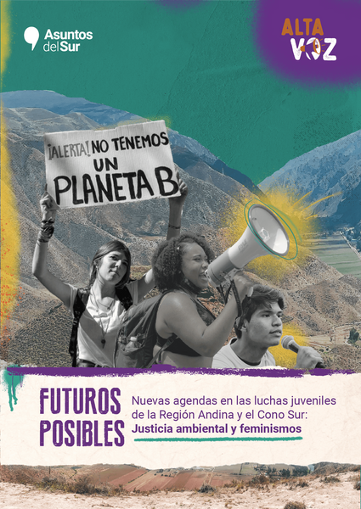
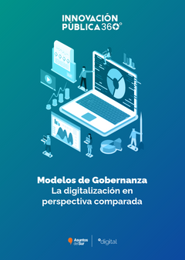
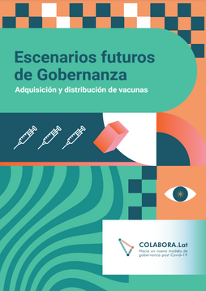
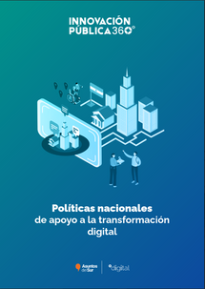
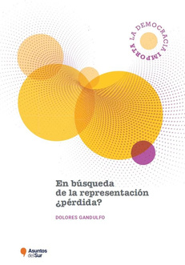
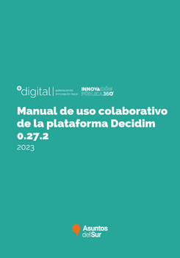
Publications
Replicable tools and experiences, systematize learning, recommendations and generate knowledge of all kinds.

Slide 5

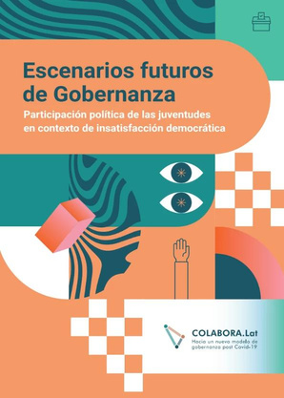
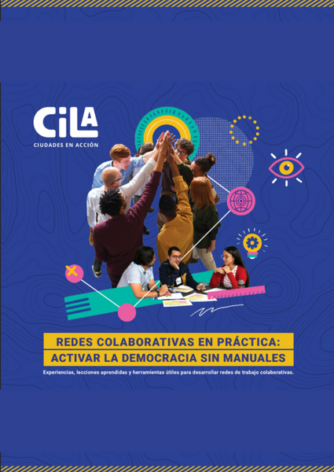
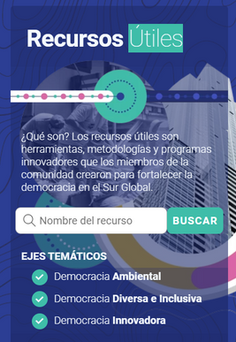
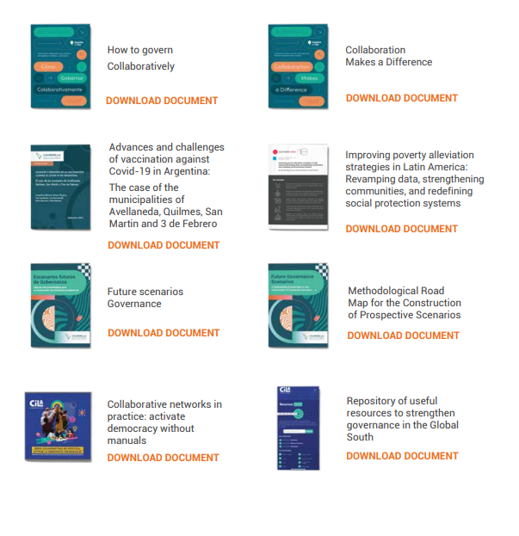
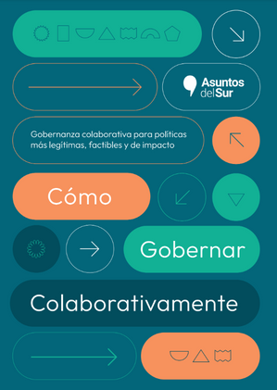
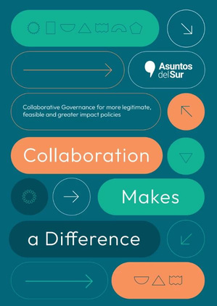
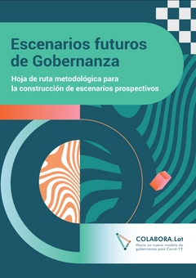
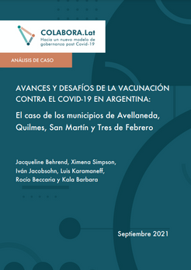
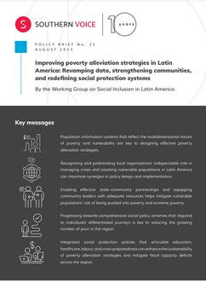
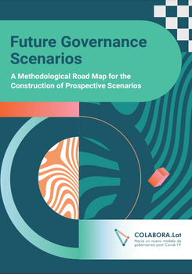
Publications

Slide 6





A training space for Public Innovation
+18500
36
LEADERS TRAINED
COUNTRIES
We conduct training programs for:
Goverments
Civil society organizations
Leaders in the region
46
COURSES

Slide 7
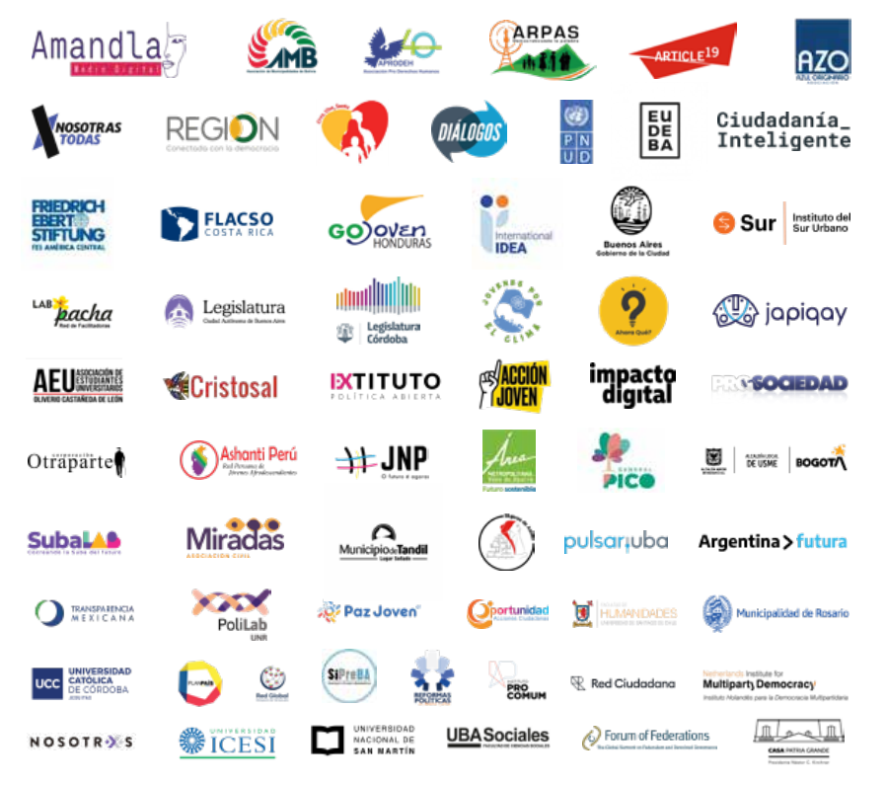
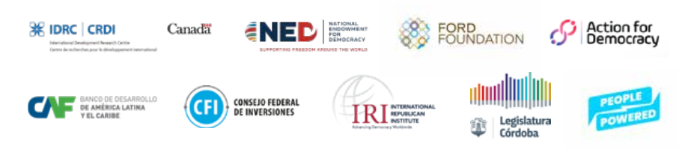

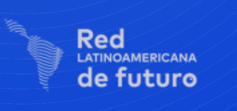
Alliances
Donors and sponsors
Networks we are part of:

Slide 8
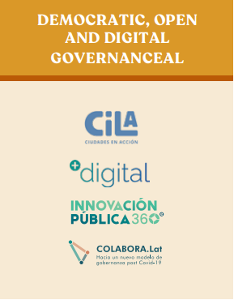
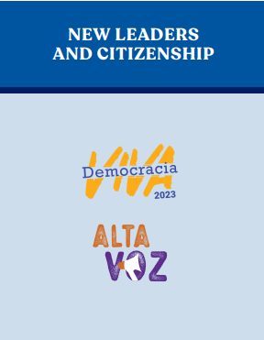
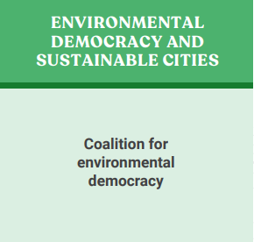
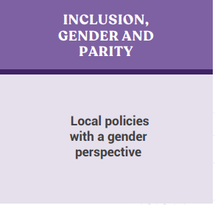

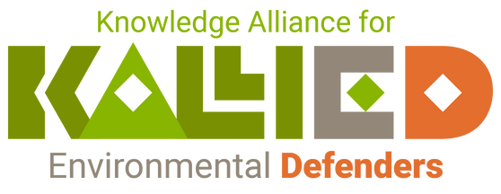
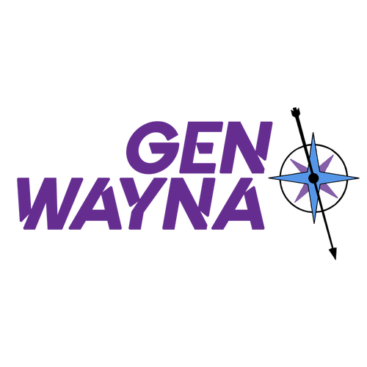
Programmatic Lines

Slide 9

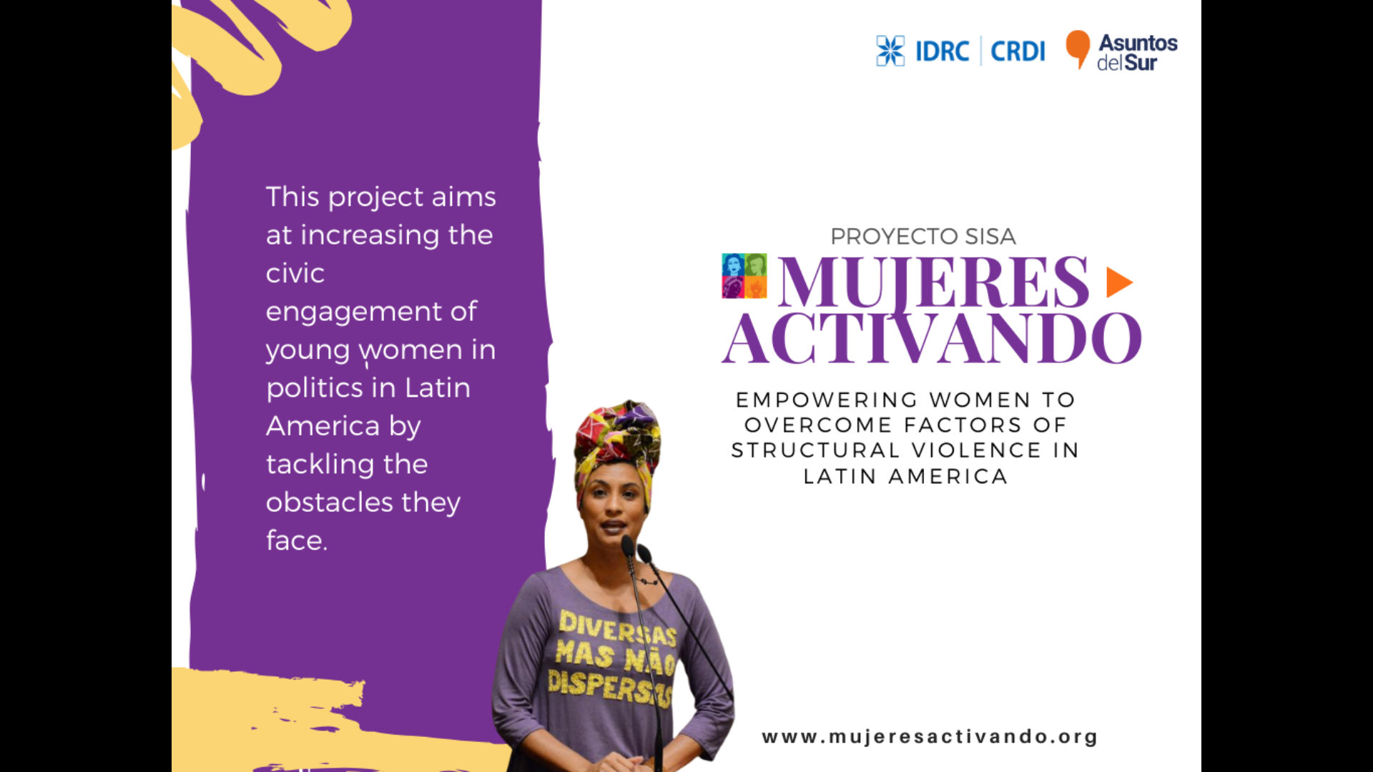

Slide 10

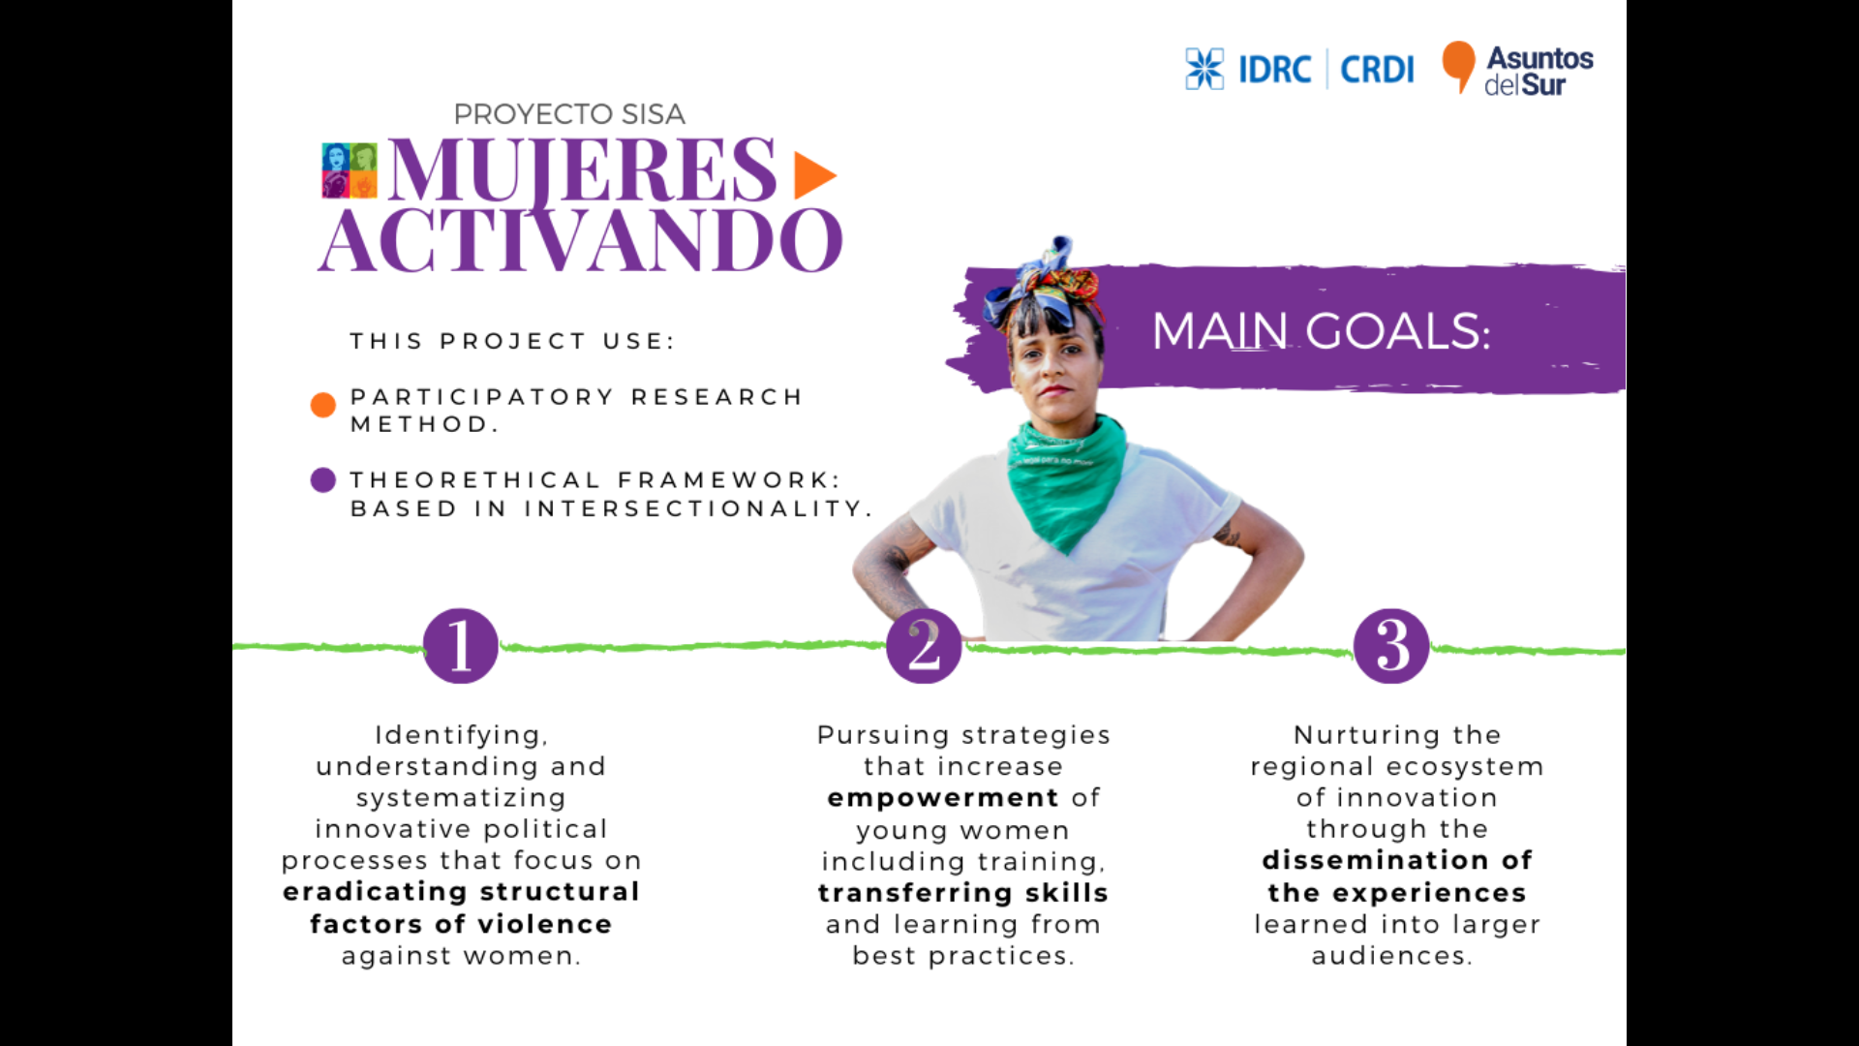

Slide 11
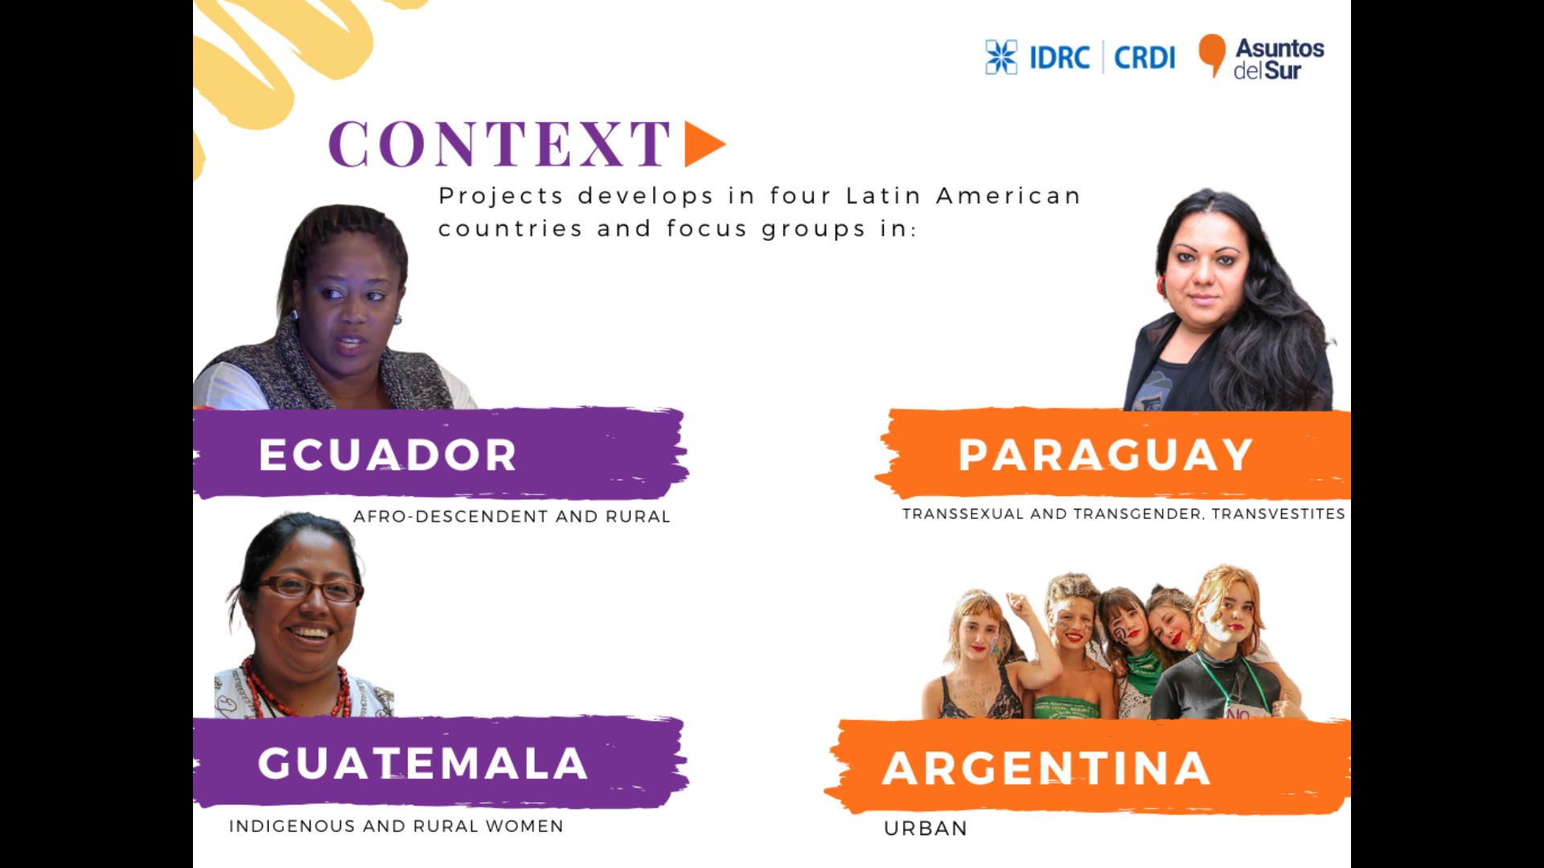

Slide 12
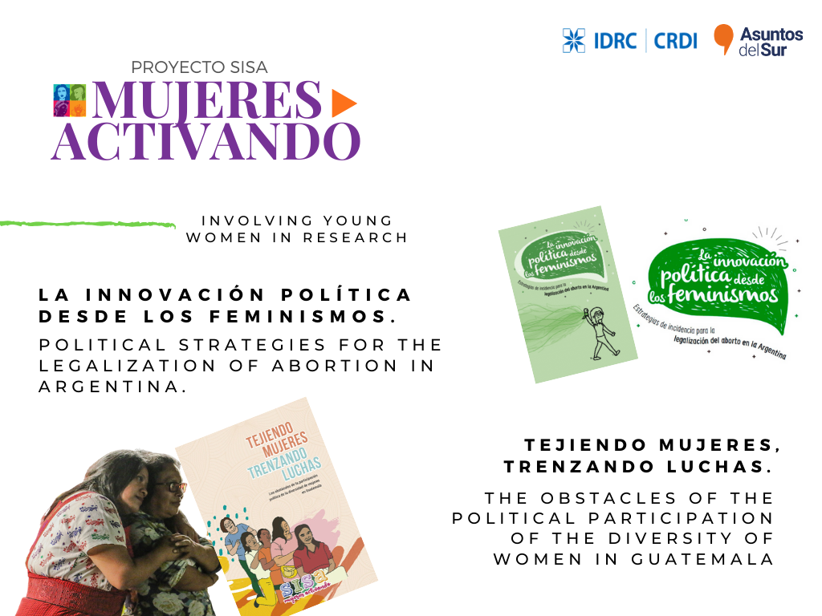

Slide 13
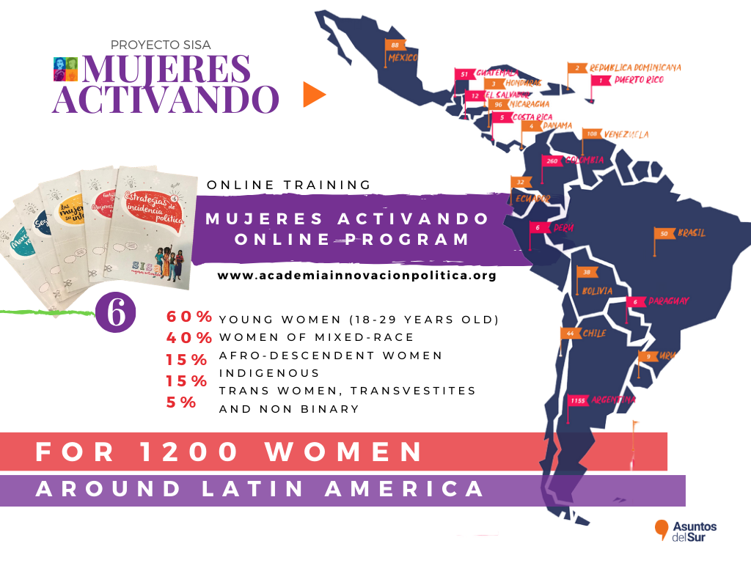

Slide 14
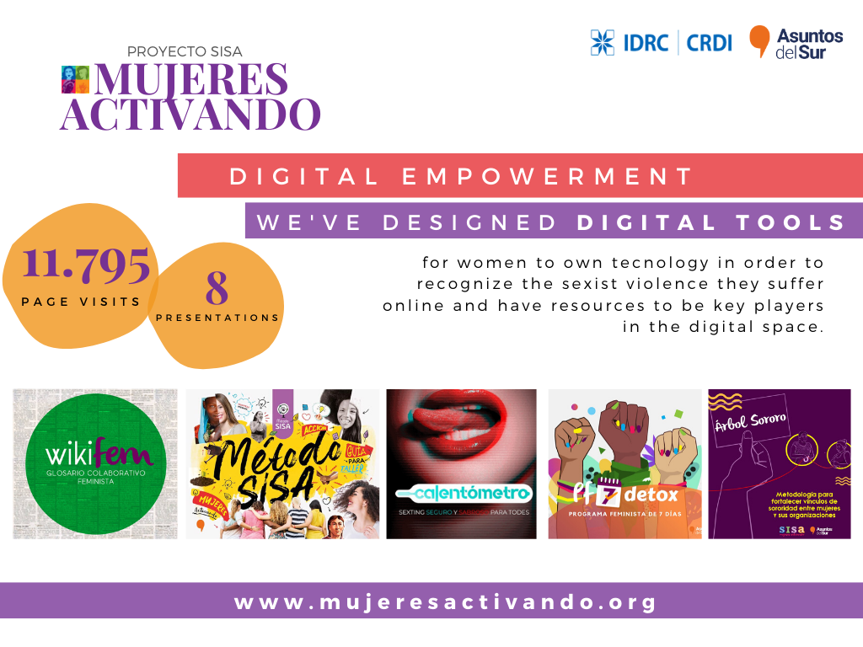

Slide 15
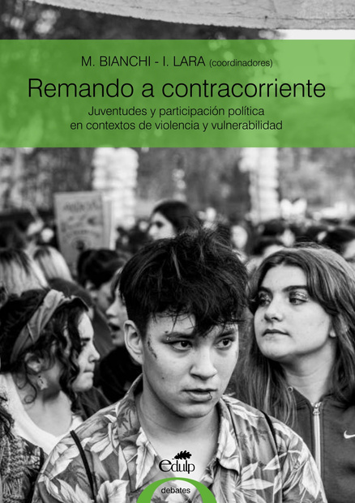
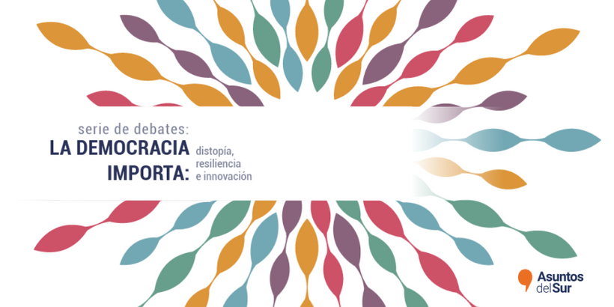
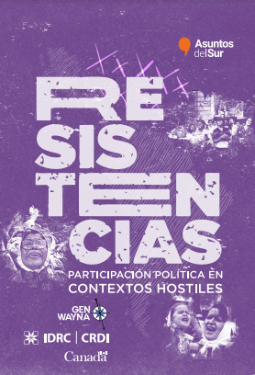
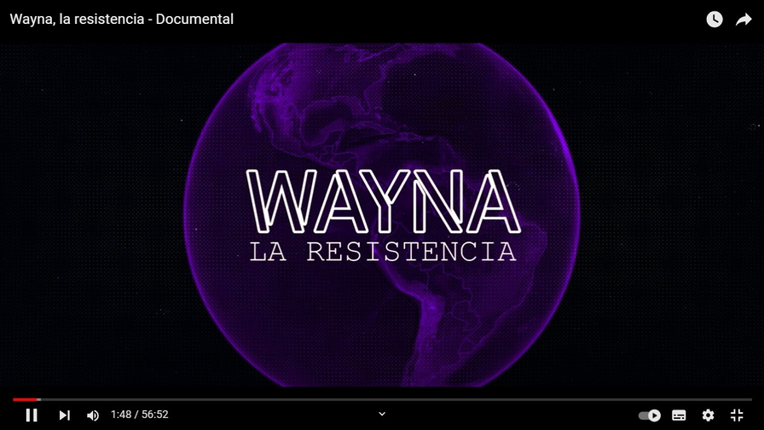
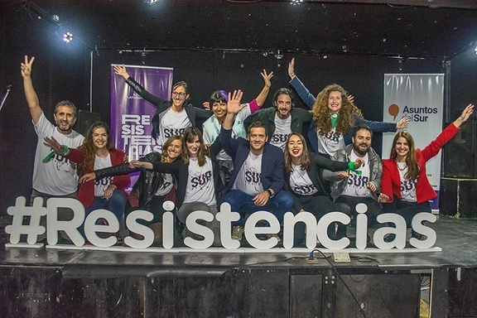
“Remando a contracorriente”
“La Democracia Importa”
Serie of discussions
“Resistencias”
Political participation in hostils contexts
Wayna, la resistencia - Documentary

Slide 16


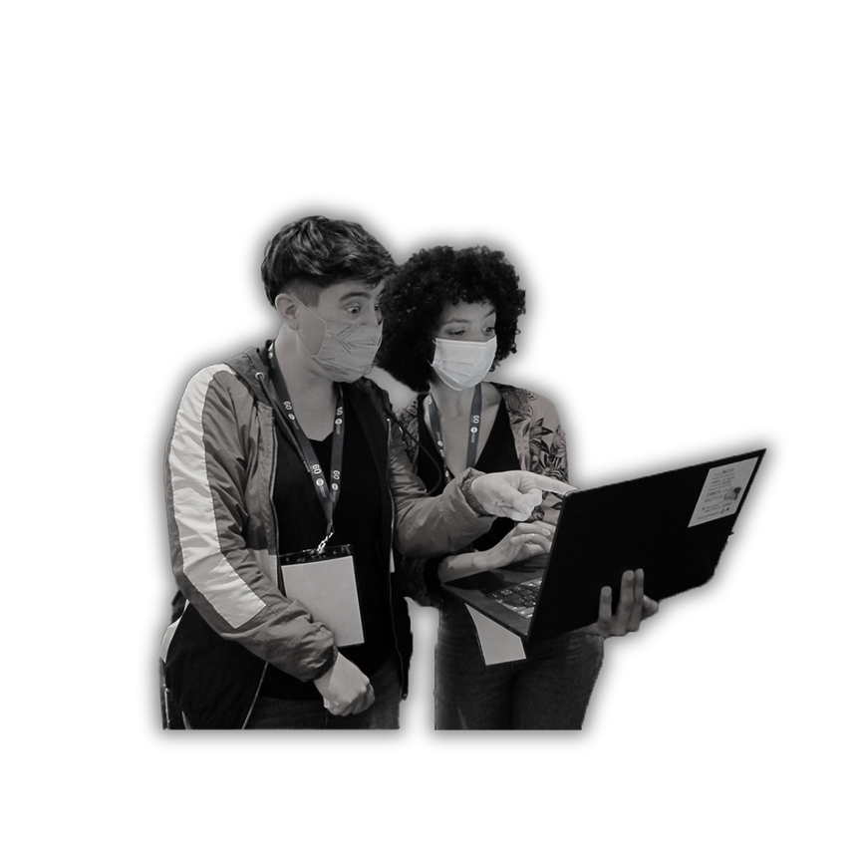


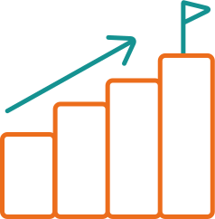
We study and generate recommendations on public policy governance models and social initiatives implemented in response to the COVID-19 pandemic.
KNOWLEDGE
TRANSFER
RESEARCH
IMPACT

Slide 17

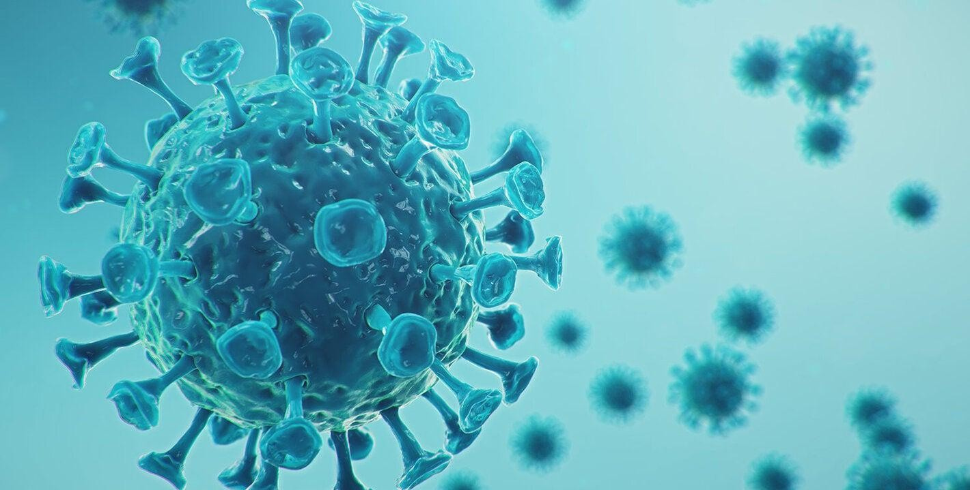
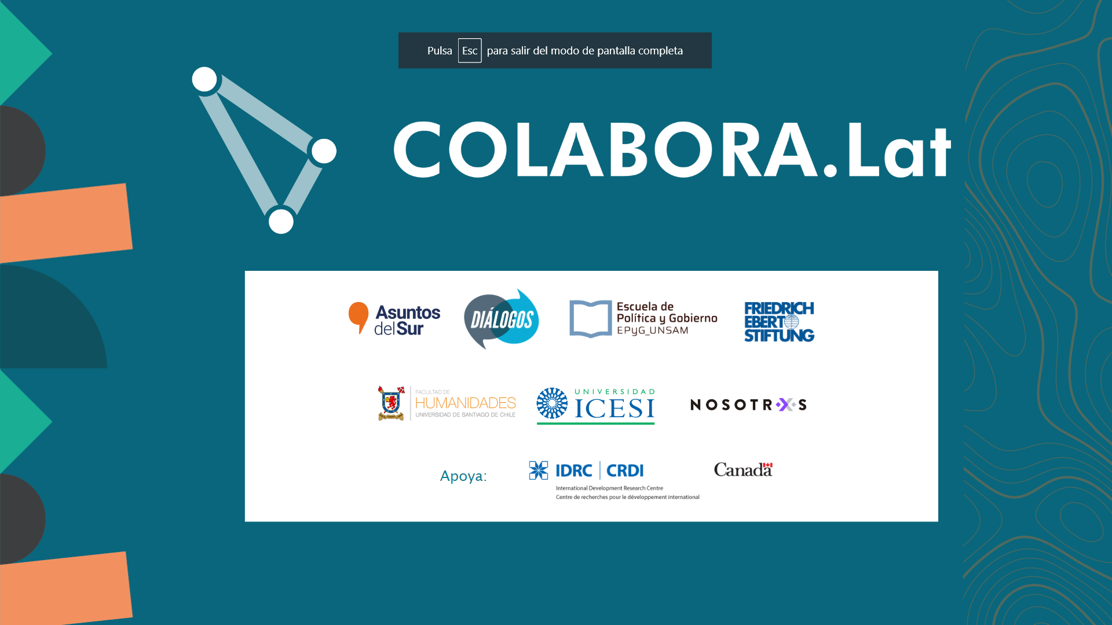

Slide 18
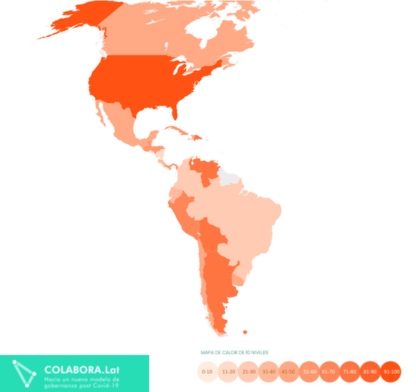
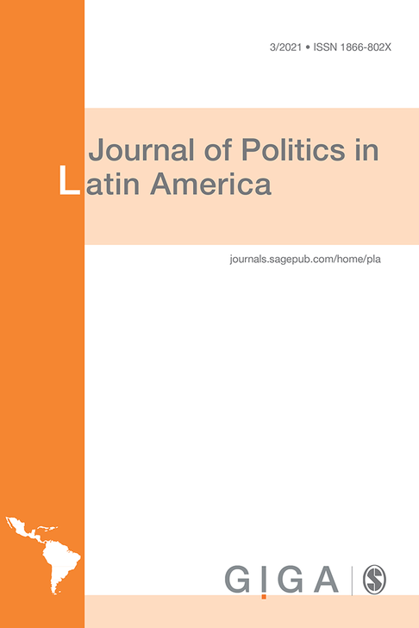
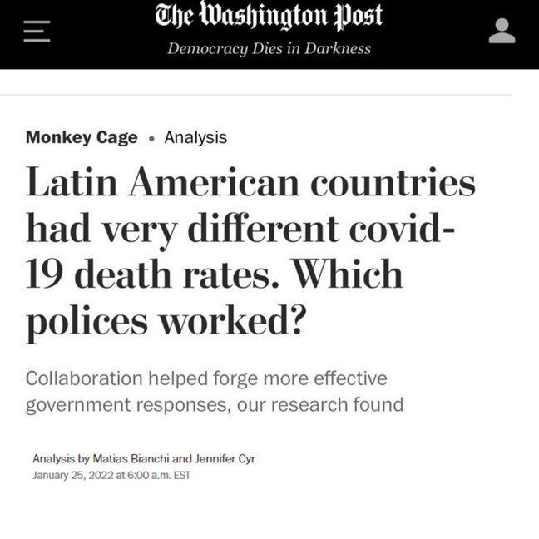
Index of collaborative governance in times of pandemic COVID-19
An innovative and open index of Collaborative Governance in times of pandemic Covid-19
Article published by the Journal of Politics in Latam. One of the four most cited articles in the journal's last three years
Analysis published by The Washigton Post
by Matias Bianchi and Jennifer Cyr

Slide 19


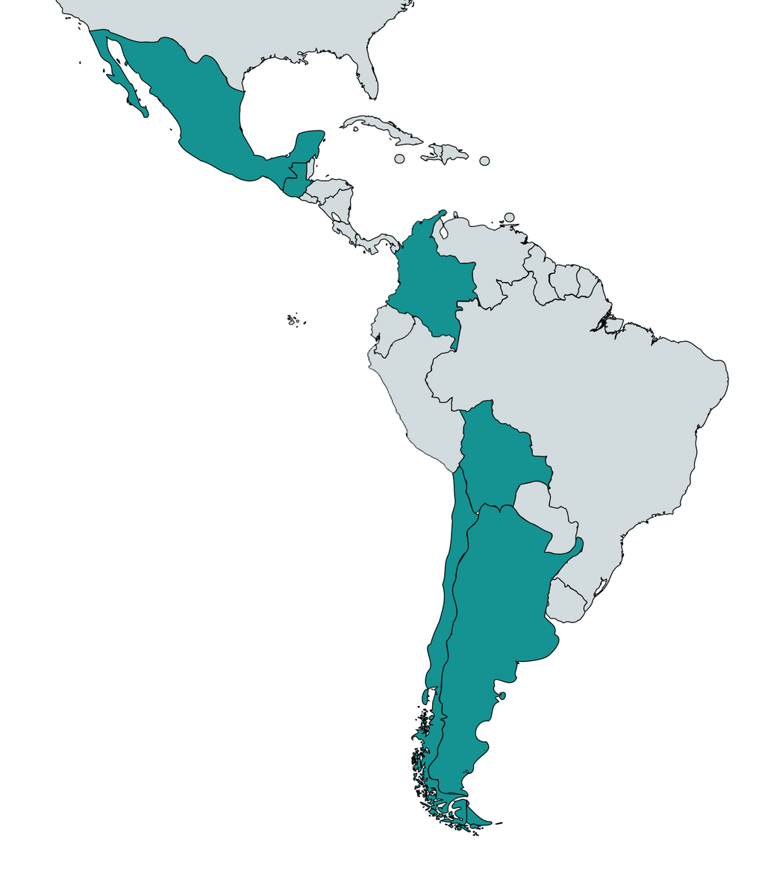



MÉXICO
Domestic workers
State of Jalisco and State of Mexico
Migrants
Tijuana (Baja California) and Ciudad Juarez (Chihuahua)
COLOMBIA
Afro-descendant youth and women
Cali, Buenaventura and Puerto Tejada
BOLIVIA
Women working in the informal sector
City of La Paz and El Alto
GUATEMALA
Low-income urban youth
Amatitlán Municipality (Department of Guatemala) and Cobán Municipality (Department of Alta Verapaz)
ARGENTINA
Vulnerable sectors
San Martín, Tres de Febrero, Quilmes and Avellaneda municipalities.
CHILE
Population at risk and economic impact
Municipalities La Pintana, Maipú, Cerro Navia and Renca (Stgo. de Chile)

Slide 20

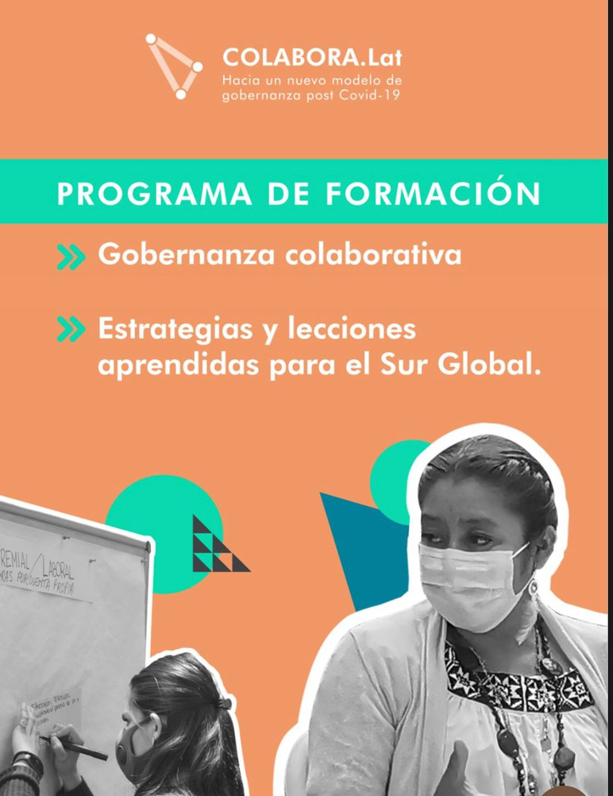


Three years of
Collaboration
Governing Collaboratively
being carried out in each of the countries of the consortium
2024
2023
2022
Book: Rethinking Governance in Latin America (Fondo de Cultura Económica)
2021
Latin American Forum to Recover the Democratic Initiative
Regional Meeting Colabora.Lat: A collaborative response to complex problems
Global Forum Colabora.Lat 2021: Governing the Pandemic
43
13
representatives
from diverse sectors
countries
5
800
85
40
days
participants
speakers
countries
171
17
participants
speakers

Slide 21

COLLABORATION MAKES A DIFFERENCE
COLLABORATIVE GOVERNANCE FOR MORE LEGITIMATE, FEASIBLE AND HIGH-IMPACT POLICIES

Slide 22

FUTURE GOVERNANCE SCENARIOS
IDENTIFYING TRENDS AND GENERATING PROPOSALS FOR DEALING WITH FUTURE UNCERTAINTY

Slide 23






Achievements
OUTPUTS
OUTCOMES
854
Used by:
participants in training program
OSC -Práctica (México)
Public institutions - President´s Cabinet (Argentina)
Networks - People Vaccine Alliance (the Latin American Chapter)
CELAC
Consortium for EU-Global Gateway
Kallied initiative
1
book
73
final projects on the implementation of collaborative governance
Presentations at international forums:
T20
20
publications
19
countries
73
final projects on the implementation of collaborative governance
20
publications

Slide 24









Slide 25



Main Goals
Promote collaboration and exchange:
focus on the challenges and opportunities for climate activists in the Global South.
Increase its impact by creating common communication strategies and advocacy actions.

Slide 26


Global South

Slide 27




























I N N U M B E R S
+ 23 C O U N T R I E S Latin America África Asia Middle East 9 P R O J E C T S

Slide 28



Projects
A Green Spring? Environmental Activism as a Catalyst for Social Change in the MENA Region
Enabling climate action in Philippines, Cambodia and Indonesia
Guardians Under Pressure: Southeast Asian Indigenous Environmental Defenders and Civic Spaces
Climate Change, Land Rights, and the Fight for Social and Environmental Justice in the Arab Region
Affectation of rights, socio-environmental degradation and threats to civic space
Combating Climate Change in Liberia
Researching Green Activism in East Africa
Promotion and Protection of Civic Space as a Strategy of Resilience and Climate Justice in Central America
Resistance and Resilience: Collaborative responses to online attacks on environmental defender

Slide 29





Activities
Training sessions implementation. Online workshop (contextual research). Synthesis notes
Preliminary report.
Constitution and the first meeting of the Cohort Committee.
OCT-NOV
DEC-JAN
FEB-APR
MAY-JUN
JUL-NOV
Establishment of AdS working groups.
Bilateral meetings with project leaders.
Design Training Proposal (collaboratively).
Cohort branding and website development.
Impact pathways.
Workshop (in-person).
T20 Side Event in Rio (Brazil)

Slide 30









THANK YOU!
@AsuntosDelSur
info@asuntosdelsur.org
www.asuntosdelsur.org

